Slide 1
UNIT 2
Attenuation – Absorption, Attenuation units

Slide 2
Attenuation
Signal attenuation (also known as fiber loss or signal loss) as is one of the most important properties of an optical fiber because it largely determines the maximum unamplified or repeaterless separation between a transmitter and a receiver.
Since amplifiers and repeaters are expensive to fabricate, install, and maintain, the degree of attenuation in a fiber has a large influence on system cost.
Of equal importance is signal distortion.
The distortion mechanisms in a fiber cause optical signal pulses to broaden as they travel along a fiber.
If these pulses travel sufficiently far, they will eventually overlap with neighboring pulses, thereby creating errors in the receiver output.
The signal distortion mechanisms thus limit the information-carrying capacity of a fiber.

Slide 3
Attenuation of a light signal as it propagates along a fiber is an important con sideration in the design of an optical communication system; the degree of attenuation plays a major role in determining the maximum transmission distance between a transmitter and a receiver or an in-line amplifier.
The basic attenuation mechanisms in a fiber are absorption, scattering, and radiative losses of the optical energy.
Absorption is related to the fiber material, whereas scattering is associated both with the fiber material and with structural imperfections in the optical waveguide
Attenuation owing to radiative effects originates from perturbations (both microscopic and macroscopic) of the fiber geometry.

Slide 4
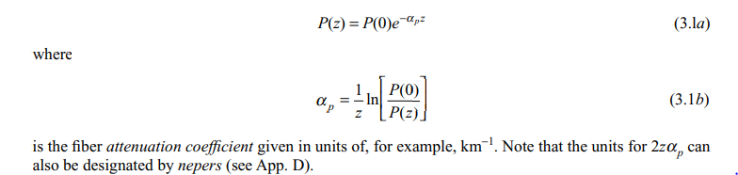
Attenuation Units
As light travels along a fiber, its power decreases exponentially with distance.
If P(0) is the optical power in a fiber at the origin (at z = 0), then the power P(z) at a distance z farther down the fiber is

Slide 5

For simplicity in calculating optical signal attenuation in a fiber, the common procedure is to express the attenuation coefficient in units of decibels per kilometer, denoted by dB/km. Designating this parameter byα . This parameter is generally referred to as the fi ber loss or the fi ber attenuation. It depends on several variables

Slide 6
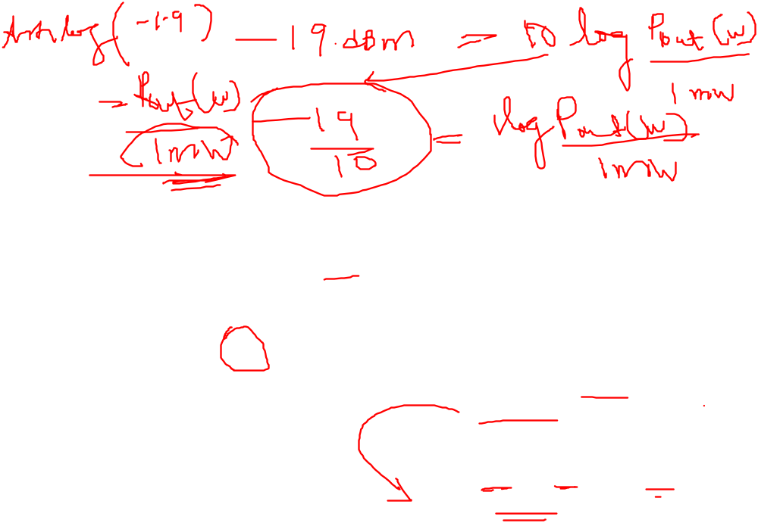
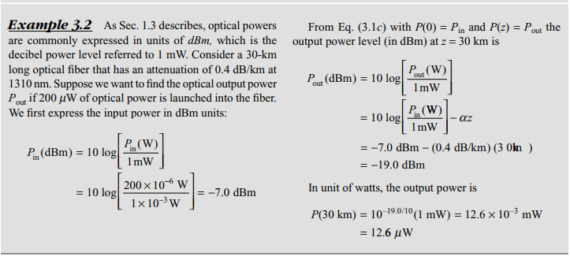

Slide 7
Absorption
Absorption is caused by three different mechanisms:
Absorption by atomic defects in the glass composition.
Extrinsic absorption by impurity atoms in the glass material.
Intrinsic absorption by the basic constituent atoms of the fiber material

Slide 8

Atomic defects are imperfections in the atomic structure of the fiber material. Examples of these defects include missing molecules, high-density clusters of atom groups, or oxygen defects in the glass structure.
Usually, absorption losses arising from these defects are negligible compared with intrinsic and impurity absorption effects.
However, they can be significant if the fiber is exposed to ionizing radiation, as might occur in a nuclear reactor environment, in medical radiation therapies, in space missions that pass through the earth’s Van Allen belts, or in accelerator instrumentation.
In such applications, high radiation doses may be accumulated over several years.

Slide 9

The basic response of a fiber to ionizing radiation is an increase in attenuation owing to the creation of atomic defects, or attenuation centers, that absorb optical energy. The higher the radiation level, the larger the attenuation, as Fig. 3.1a illustrates. However, the attenuation centers will relax or anneal out with time, as shown in Fig. 3.1b. The degree of the radiation effects depends on the dopant materials used in the fi ber. Pure silica fi bers or fi bers with a low Ge doping and no other dopants have the lowest radiation-induced losses.

Slide 10
The basic response of a fiber to ionizing radiation is an increase in attenuation owing to the creation of atomic defects, or attenuation centers, that absorb optical energy.
The higher the radiation level, the larger the attenuation.
However, the attenuation centers will relax or anneal out with time.
The degree of the radiation effects depends on the dopant materials used in the fiber. Pure silica fibers or fibers with a low Ge doping and no other dopants have the lowest radiation-induced losses.

Slide 11
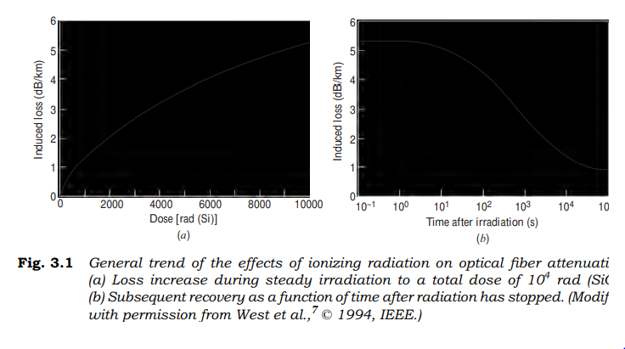
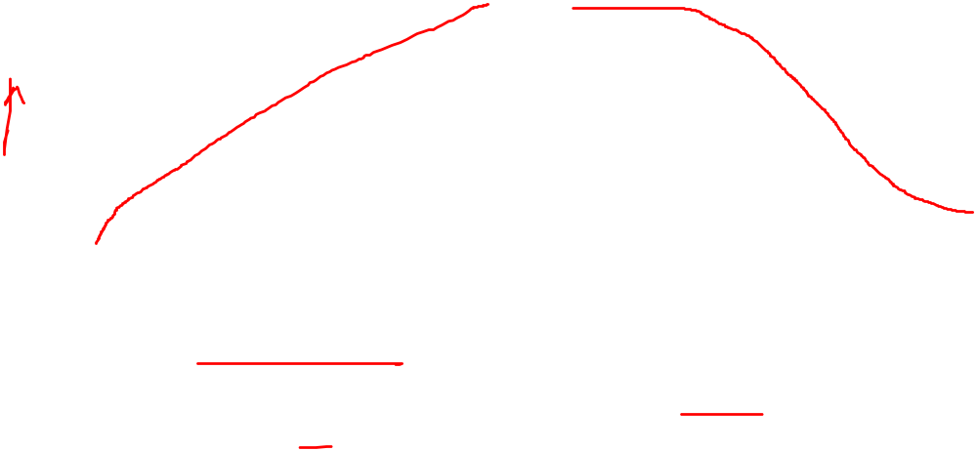

Slide 12
Absorption
The dominant factor in silica fiber is the presence of minute quantities of impurities in the fiber material. these impurities include OH⁻ (water) ions that are dissolved in the glass and transition metal ions such as iron ,copper, chromium and vanadium.
The presence of OH ion impurities in a fiber preform results mainly from the ox hydrogen flame used in hydrolysis reaction.
The peaks and valleys in the attenuation curves resulted in the designation of the various transmission window shown in figure.
By reducing the residual OH content fiber below 1ppb,standard commercially available single mode fiber have nominal attenuation s of 0.4dB /km at 1310nm and less than 0.25 dB/km at 1550nm.

Slide 13
Impurity absorption losses occur either because of electron transitions between the energy levels within these ions or because of charge transitions between ions.
The absorption peaks of the various transition metal impurities tend to be broad, and several peaks may overlap, which further broadens the absorption in a specific region.
Modern vapor-phase fiber techniques for producing a fiber preform have reduced the transition-metal impurity levels by several orders of magnitude. Such low impurity levels allow the fabrication of low-loss fibers.

Slide 14
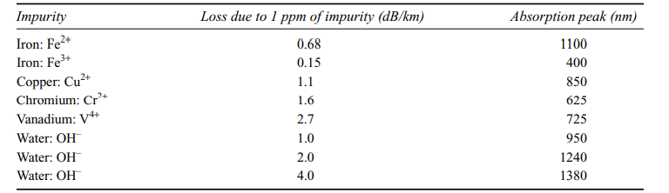

Slide 15
The presence of OH ion impurities in a fi ber preform results mainly from the oxyhydrogen flame used in the hydrolysis reaction of the SiCl4, GeCl4, and POCl3 starting materials.
Water impurity concentrations of less than a few parts per billion (ppb) are required if the attenuation is to be less than 20 dB/km.
The high levels of OH ions in early fibers resulted in large absorption peaks at 725, 950, 1240, and 1380 nm.
Regions of low attention lie between these absorption peaks.

Slide 16
The peaks and valleys in the attenuation curves resulted in the designation of the various transmission windows shown in Fig.
By reducing the residual OH content of fibers to below 1 ppb, standard commercially available single-mode fibers have nominal attenuations of 0.4 dB/km at 1310 nm (in the O-band) and less than 0.25 dB/km at 1550 nm (in the C-band).
Further elimination of water ions diminishes the absorption peak around 1440 nm and thus opens up the E-band for data transmission, as indicated by the dashed line in Fig.
Optical fibers that can be used in the E-band are known by names such as low water-peak or full-spectrum fibers.

Slide 17
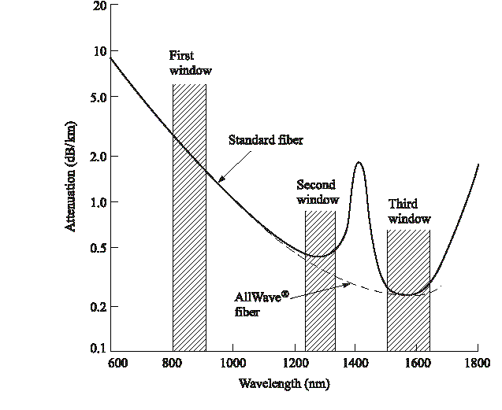
Fig. 3-1: Optical fiber attenuation
Notes:
1

Slide 18
Intrinsic absorption is associated with the basic fiber material
It is defined as the absorption that occurs when the material is in a perfect state with no density variations, impurities, or material inhomogeneities.
Intrinsic absorption results from electronic absorption bands in the ultra violet region and from atomic vibration bands in the near-infrared region. The electronic absorption bands are associated with the band gaps of the amorphous glass materials.
Absorption occurs when a photon inter acts with an electron in the valence band and excites it to a higher energy level

Slide 19
Scattering Losses
Due to microscopic variation in the material density
Compositional fluctuation
Structural inhomogeneities
defects occurring during fiber manufacture
Glass is composed of a randomly connected network of molecules. Such a structure naturally contains regions in which the molecular density is either higher or lower than the average density in the glass
Glass made up of several oxides SiO₂,GeO₂,P₂O₅
The above effects vary the refractive index variations which occur with in the glass over distances that are small compared to the wavelengths.
These index variations cause a Rayleigh-type scattering of the light. Rayleigh scattering in glass is the same phenomenon that scatters light from the sun in the atmosphere, thereby giving rise to a blue sky

Slide 20
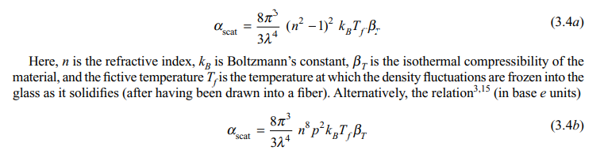
The expressions for scattering-induced attenuation are fairly complex owing to the random molecular nature and the various oxide constituents of glass.
For single-component glass the scattering loss at a wavelength l (given in mm) resulting from density fluctuations can be approximated by

Slide 21
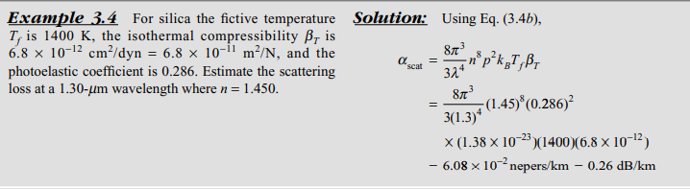


Slide 22
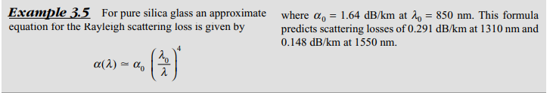

Slide 23
Structural inhomogeneities and defects created during fiber fabrication can also cause scattering of light out of the fiber.
These defects may be in the form of trapped gas bubbles, unreacted starting materials, and crystallized regions in the glass.
In general, the preform manufacturing methods that have evolved have minimized these extrinsic effects to the point where scattering that results from them is negligible compared with the intrinsic Rayleigh scattering.
Since Rayleigh scattering follows a characteristic dependence, it decreases dramatically with increasing wavelength,
The losses of multimode fibers are generally higher than those of single-mode fibers.
This is a result of higher dopant concentrations and the accompanying larger scattering loss due to greater compositional fluctuation in multimode fibers.
In addition, multimode fibers are subject to higher-order-mode losses owing to perturbations at the core-cladding interface.

Slide 24
Rayleigh Scattering
It occurs because the molecules of silicon dioxide have some freedom when adjacent to one another. Thus, setup at irregular positions and distances with respect to one another when the glass is rapidly cooled during the final stage of the fabrication process. Those structural variations are seen by light as variations in the refractive index, thus causing the light to reflect – that is, to scatter – in different directions
Rayleigh scattering is a scattering of light by particles much smaller than the wavelength of the light, which may be individual atoms or molecules. Rayleigh scattering is a process in which light is scattered by a small spherical volume of variant refractive index, such as a particle, bubble, droplet, or even a density fluctuation.
As light travels in the core, it interacts with the silica molecules in the core. Rayleigh scattering is the result of these elastic collisions between the light wave and the silica molecules in the fiber. Rayleigh scattering accounts for about 96 percent of attenuation in optical fiber

Slide 25
Rayleigh Scattering
Causes of Rayleigh Scattering:
It results from non-ideal physical properties of the manufactured fiber.
It results from inhomogeneities in the core and cladding.
Because of these inhomogeneities problems occur like –
a) Fluctuation in refractive index
b) density and compositional variations.
Minimizing of Rayleigh Scattering:
Rayleigh scattering is caused due to compositional variations which can be reduced by improved fabrication.

Slide 26
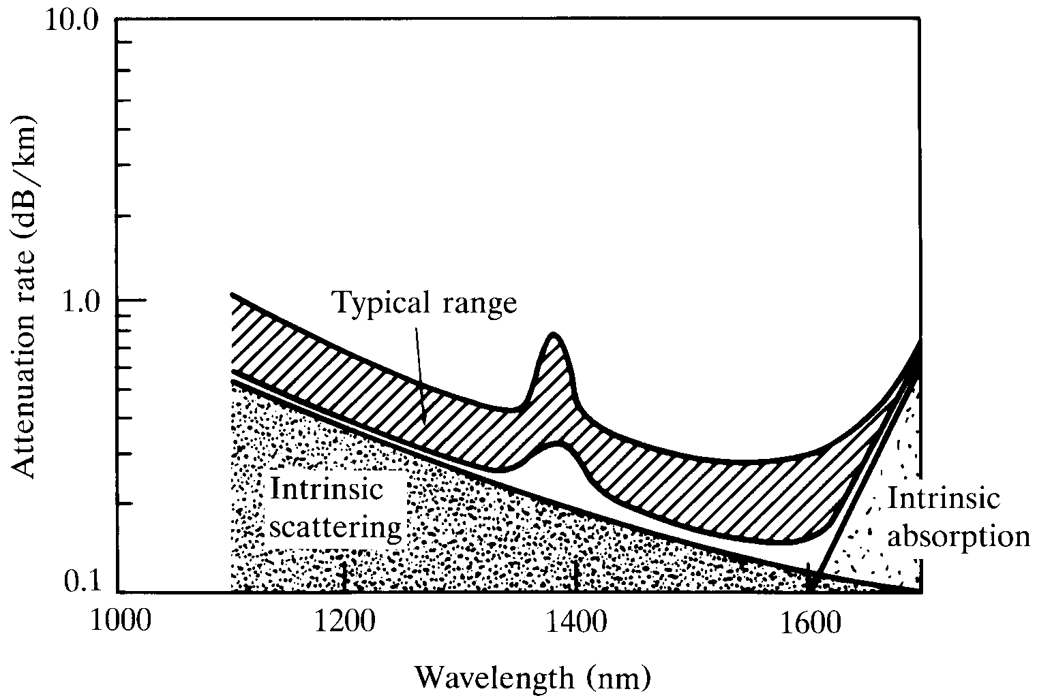
Single-mode fiber attenuation
Notes:
4

Slide 27
Fiber Bending Loss
Radiative losses occur whenever an optical fiber undergoes a bend of finite radius of curvature.
Fibers can be subject to two types of curvatures:
(a) macroscopic bends having radii that are large compared with the fiber diameter, such as those that occur when a fiber cable turns a corner
(b) random microscopic bends of the fiber axis that can arise when the fibers are incorporated into cables.

Slide 28
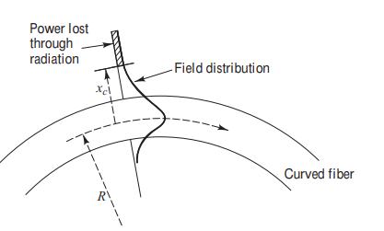

Slide 29
Macro Bending
For slight bends, the loss is extremely small and is not observed.
As the radius of curvature decreases, the loss increases exponentially until at a certain critical radius of curvature loss becomes observable.
If the bend radius is made a bit smaller once this threshold point has been reached, the losses suddenly become extremely large.
It is known that any bound core mode has an evanescent field tail in the cladding which decays exponentially as a function of distance from the core. Since this field tail moves along with the field in the core, part of the energy of a propagating mode travels in the fiber cladding.
When a fiber is bent, the field tail on the far side of the centre of curvature must move faster to keep up with the field in the core, for the lowest order fiber mode.

Slide 30
At a certain critical distance x_{c,} from the centre of the fiber; the field tail would have to move faster than the speed of light to keep up with the core field.
Since this is not possible the optical energy in the field tail beyond x_{c} radiates away.
The amount of optical radiation from a bent fiber depends on the field strength at x_{c} and on the radius of curvature R.
Since higher order modes are bound less tightly to the fiber core than lower order modes, the higher order modes will radiate out of the fiber first.

Slide 31
Micro Bending
Another form of radiation loss in optical waveguide results from mode coupling caused by random micro bends of the optical fiber.
Micro bends are repetitive small scale fluctuations in the radius of curvature of the fiber axis.
They are caused either by non uniformities in the manufacturing of the fiber or by non uniform lateral pressures created during the cabling of the fiber.
An increase in attenuation results from micro bending because the fiber curvature causes repetitive coupling of energy between the guided modes and the leaky or non guided modes in the fiber.
Micro bending losses can be minimized by placing a compressible jacket over the fiber.
When external forces are applied to this configuration, the jacket will be deformed but the fiber will tend to stay relatively straight.

Slide 32
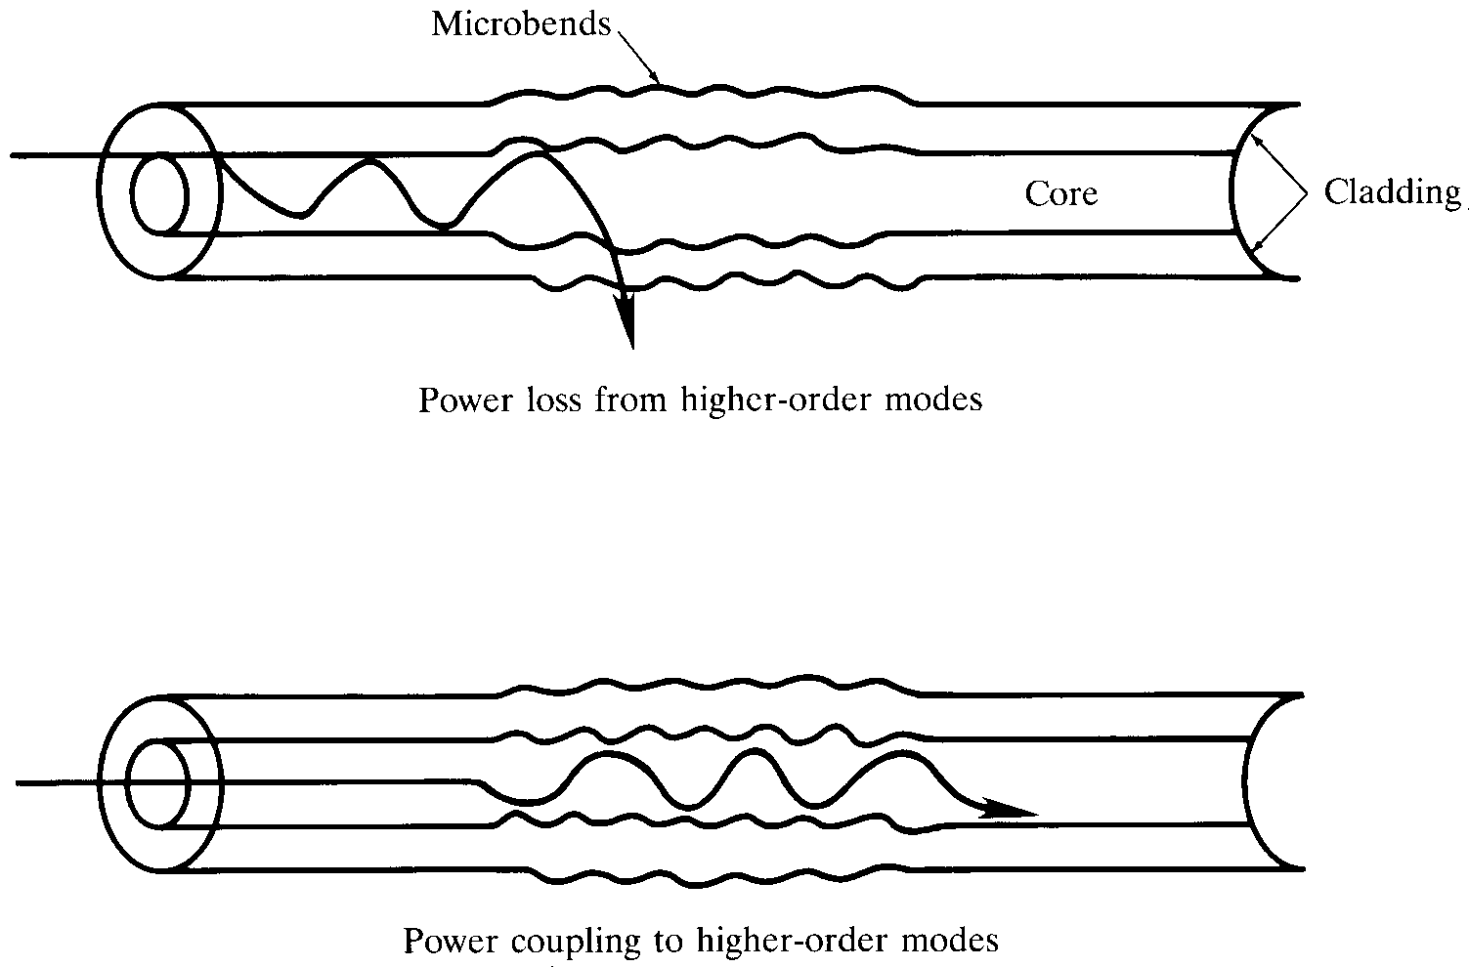
Microbending losses
Notes:
6

Slide 33
Cabling and Packaging losses
Non uniformities in the manufacturing of the fiber by non uniform lateral pressure during the cabling of fiber

Slide 34
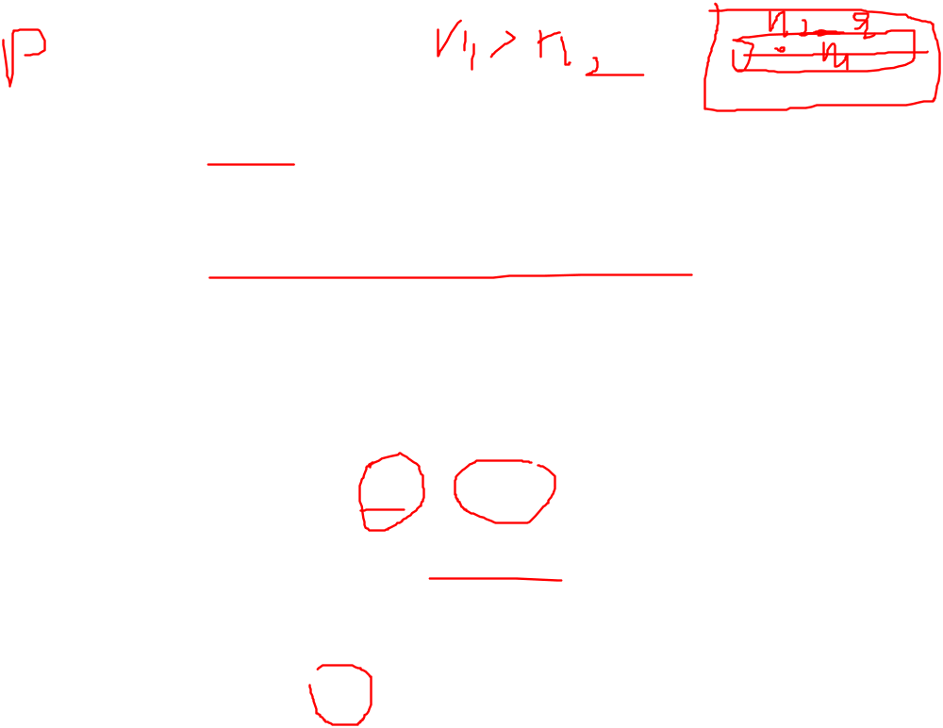

Core and cladding losses
The core and cladding have different indices of refraction and therefore differ in composition, the core and cladding generally have different attenuation coeffi cients, denoted α₁ and α₂ , respectively.
The loss for a mode of order (n, m) for a step-index waveguide is

Slide 35

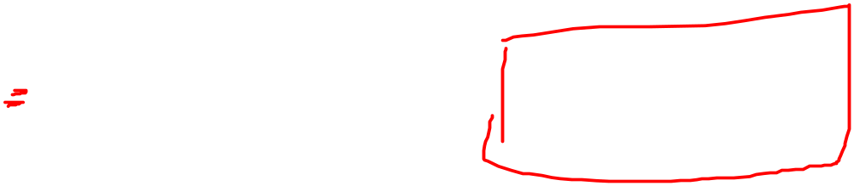

P_{core}/P and P_{clad}/P are the fractional powers.
For the case of a graded-index fiber the situation is much more complicated.
In this case, both the attenuation coefficients and the modal power tend to be functions of the radial coordinate.
At a distance r from the core axis the loss is
where α₁ and α₂ are the axial and cladding attenuation coefficients

Slide 36
Connector and Splices loss
Interconnection of different fiber lengths is a necessary requirement for the assembly of complex fiber transmission and signal manipulation networks. Whether via demountable, physical coupling (via connectorization) or by irreversible splicing techniques (e.g. fusion splicing) alignment of the fiber cores is critical to minimize losses associated with the connection.
In a general sense, successful connections will minimize lateral offset of the core centers, angular misalignment, tilt, and longitudinal displacement (i.e. the formation of a gap).
It is also possible that the two fibers to be joined have different absolute core dimensions and varied core-clad diameter ratios as well as different core and cladding glass compositions.

